Slide 1
Elective Recommendation System Using Machine Learning
PIP104 University Project II
Final Viva - Voce
Batch Number: CSD-G30
Name | Roll No
SAHANA R | 20211CSD0108
AKASH KARTHIK RAO | 20201CSD0130
PRATHIKSHA M | 20211CSD0019
SRINIDHI S | 20211CSD0114
AMPANA J | 20211CSD0110
Under the Supervision of,
Prof. Dr. Marimuthu K
Professor
School of Computer Science
Presidency University
Name of the Program: B.Tech
Name of the HoD: Dr. Saira Banu Atham
Name of the Program Project Coordinator: Dr Manjula H M
Name of the School Project Coordinators: Dr. Sampath A K / Dr. Abdul Khadar A / Mr. Md Ziaur Rahman

Slide 2
Introduction
Elective courses play a pivotal role in higher education by providing students with the flexibility to shape their academic journeys. Unlike core courses, electives allow students to pursue topics of personal interest, enhance skills outside their primary discipline, or deepen knowledge in a specialized area aligned with career goals.
The current allocation process is primarily manual, where administrators, Heads of Departments (HoDs), and timetable committees decide the distribution of students into electives. While these efforts aim to balance course enrollments, they often fail to account for individual preferences, social dynamics, or equitable seat allocation.
This leads to dissatisfaction among students, administrative inefficiencies, and underutilized resources. Addressing these issues is critical to ensuring that students can maximize the benefits of electives and that the university maintains its academic standards and operational efficiency.

Slide 3
Literature Review
Elective course recommendation systems rely on sophisticated algorithms to streamline and optimize the selection process. The literature highlights several methods that can be applied to address the challenges associated with elective allocation. Among these, cross-domain recommendation systems stand out as a solution to common issues such as data sparsity and the cold-start problem, where insufficient historical data prevents accurate recommendations.
By leveraging data from related domains, such as general academic performance, these systems create a more comprehensive profile of students. For instance, a system may use a student’s strong performance in programming courses to recommend electives in artificial intelligence or data science. Frameworks like COAST capture cross-domain similarities, improving recommendation accuracy across diverse academic fields.

Slide 4
Literature Review
Content-Based Filtering (CBF) is another widely used method, offering recommendations by analyzing a student’s academic history and matching it with the features of available electives. For example, a system could recommend electives with a similar difficulty level or thematic focus as those a student previously excelled in.
CBF is particularly effective in aligning recommendations with individual academic strengths, ensuring that students are placed in courses where they are likely to succeed. However, its major drawback is over-specialization, where students receive suggestions that are too similar to their prior choices. This narrows the range of opportunities for exploration, limiting the diversity of a student’s academic experience.

Slide 5
Research Gaps Identified
1. Cold-Start Problem:
One of the most prominent challenges in recommendation systems, particularly in the context of elective course selection, is the cold-start problem. This occurs when there is insufficient data about new students or new electives
2. Balancing Academic and Social Preferences: Another critical challenge in current elective recommendation systems is the difficulty in balancing academic preferences with social preferences. Most existing systems tend to prioritize either one or the other, but not both simultaneously.
3. Scalability Issues: Scalability is another significant concern when applying recommendation algorithms to large-scale academic environments.

Slide 6
Research Gaps Identified
4. Fair Distribution: Ensuring fair distribution of students across electives is another gap in current recommendation systems. While most systems focus on personalizing recommendations based on student preferences, few take into account the need to balance enrollments across different electives. .
5. Addressing Bias and Fairness: Recommendation systems often exhibit biases (e.g., popularity bias, demographic bias) that can lead to unfair treatment of certain groups or items.

Slide 7
Proposed Methodology
1. Data Collection:
Student Profiles: This data consists of student-specific information such as academic history, performance records, department, current semester, and areas of interest.
Elective Details: Information about the available electives, such as the course title, department, prerequisites, difficulty level, popularity, and credits, is also collected.
Historical Preferences: Past elective choices, grades, and feedback from students regarding their previous course selections provide insight into their interests and preferences.
2. Collaborative Filtering:
User-Based Filtering: In this approach, the system identifies students who have similar academic profiles or past elective choices.
Item-Based Filtering: Item-based collaborative filtering focuses on finding similarities between electives. It compares the attributes of the electives themselves—such as content, difficulty, prerequisites3.Recommendation System Design :
Similarity Computation: To measure the similarity between students or electives, various mathematical techniques are used
Cosine Similarity: Measures the angle between two vectors (representing student preferences or electives) in a multidimensional space.
Pearson Correlation: Evaluates the linear relationship between two datasets, measuring how closely related the preferences or attributes of students or electives are.

Slide 8
Objectives
1.Improve Elective Selection by Considering Both Academic and Social Preferences
One of the primary goals of the Elective Recommendation System is to offer students personalized elective recommendations that take both academic and social preferences into account. Traditionally, elective allocation systems focus primarily on academic performance, recommending courses based on students past academic achievements or their program requirements.
2.Address Cold-Start Issues via Hybrid Techniques
The cold-start problem is one of the most significant challenges faced by recommendation systems, particularly when there is insufficient data about new students or newly introduced electives.
3. Enhance Scalability to Handle Dynamic, High-Dimensional Datasets
Scalability is a crucial objective for any recommendation system that aims to serve a large and diverse user base, particularly in a university setting with thousands of students and a wide variety of elective courses.

Slide 9
System Design & Implementation
1. System Overview:
The goal of the project is to develop a Hybrid Method of Collaborative Filtering for an Elective Course Recommendation System.
2. Techniques Used:
Collaborative Filtering:
The Hybrid Method of Collaborative Filtering combines user-based and item-based collaborative filtering techniques to generate recommendations.
Cosine Similarity:
Cosine similarity is used to measure the similarity between students based on their course marks.
3. System Implementation:
Data Acquisition Datasets
Student Grades Dataset: Contains student marks for various courses, which is essential for generating recommendations.
Course Details Dataset: Includes information about the courses available for enrollment, such as course codes and descriptions.

Slide 10
System Design & Implementation
5. Data Preprocessing
The preprocess_data function creates a pivot table that organizes student marks by roll number and course code
6. Similarity Computation
The compute_similarity function calculates the cosine similarity matrix for the pivot table, enabling the identification of similar students based on their course marks.
7. Recommendation Generation
The recommend_courses function generates course recommendations for a given student based on the performance of similar students.
8. User Interface
The Streamlit application provides an interactive interface where students can enter their roll numbers

Slide 11
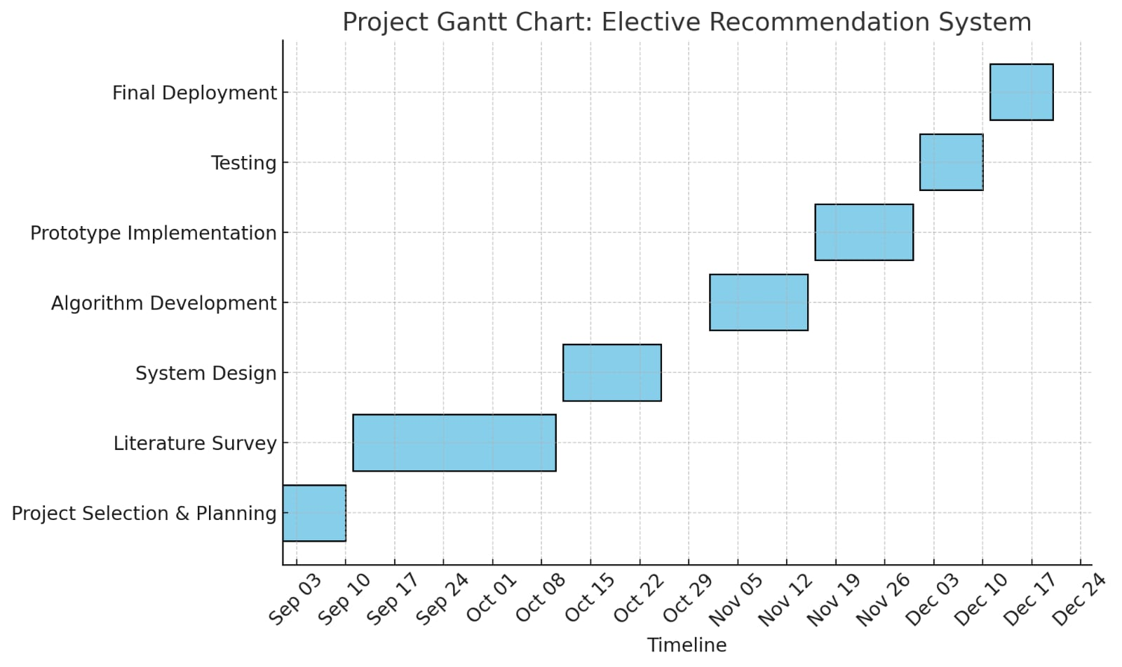
Timeline of Project

Slide 12
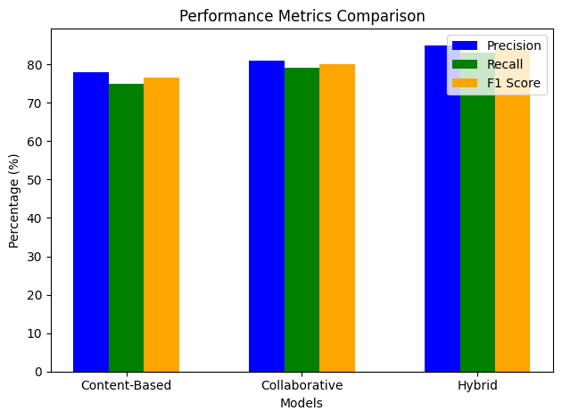
Results Obtained
1.System Accuracy:
The recommendation system achieved high precision in elective suggestions, with a significant alignment between recommended courses and students' final selections. Feedback from a pilot group of students indicated a satisfaction rate of over 85% with the recommendations, demonstrating the system's relevance and accuracy. The system's accuracy was assessed using precision, recall, and F1 score, based on student engagement and final elect

Slide 13
Results Obtained
2. Efficiency:
The system streamlined the elective selection process, reducing the average decision-making time by 40%. Administrators noted a reduction in manual efforts to guide students, freeing up time for personalized mentoring.
3. User Engagement:
Students engaged actively with the system's interface, appreciating its user-friendly design and clear course insights. A notable increase in students' confidence in their elective choices was observed, attributed to the system's data-driven approach.

Slide 14
Conclusion
In conclusion, the Elective Recommendation System has proven to be a valuable innovation in improving the elective selection process at Presidency University. By integrating data analysis with a user-friendly interface, the system offered students tailored recommendations that matched their academic goals and personal preferences, making the decision-making process more efficient and personalized.
The results demonstrate the project's positive impact on both students and the institution. Students experienced a more streamlined and satisfying selection process, reducing the time required to make informed choices. At the same time, the system provided university administrators with valuable insights into student preferences and enrollment patterns, supporting better resource allocation and curriculum planning.
While the project did encounter challenges such as incomplete data and the need for user guidance, these offer opportunities for future enhancements. Adding features like career-focused analytics and improved data validation could expand the system’s utility and effectiveness even further.

Slide 15
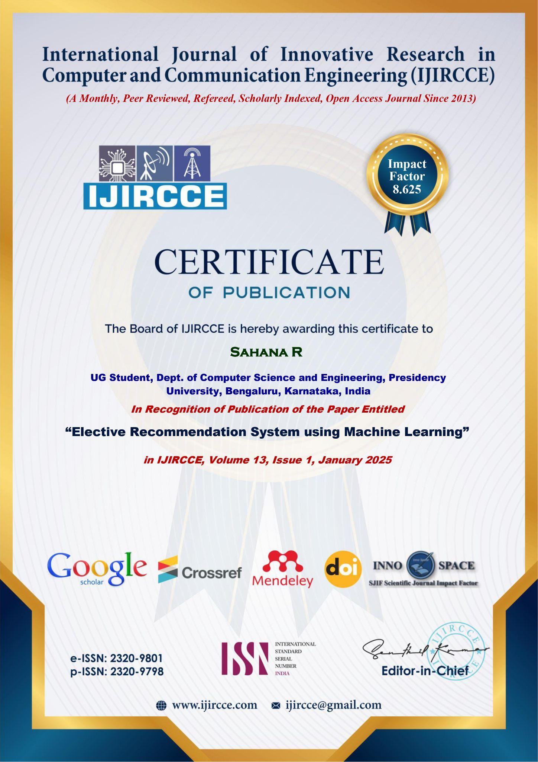
Certificates

Slide 16

Certificates

Slide 17

Certificates

Slide 18

Certificates

Slide 19

Certificates

Slide 20
Mapping project with the Sustainable Development Goals (SDGs).
SDG 4: Quality Education
The project directly contributes to improving the quality of education by personalizing elective recommendations based on academic performance, interests, and career aspirations. This tailored approach ensures that students are engaged in relevant courses, enhancing their learning outcomes and satisfaction. Furthermore, the system fosters collaborative learning by grouping students with peers, creating a more inclusive and dynamic educational experience.
SDG 9: Industry, Innovation, and Infrastructure
By integrating advanced machine learning algorithms, such as collaborative filtering and hybrid models, the project promotes innovation in educational infrastructure. The system demonstrates the use of technology to automate complex processes, reduce administrative burdens, and enhance decision-making in academic institutions. The scalable design also ensures that the system can adapt to growing student populations and new electives, supporting sustainable educational development.
SDG 10: Reduced Inequalities
The system ensures equitable access to elective courses by implementing fair allocation mechanisms. Algorithms balance enrollments to prevent over-subscription or underutilization, ensuring that all students have equal opportunities to pursue their preferred electives. This approach reduces disparities in academic opportunities, particularly for students from diverse backgrounds.
SDG 17: Partnerships for the Goals
The project’s framework, including its data-driven decision-making capabilities and integration of academic and social preferences, can be shared across institutions, fostering collaboration in education technology. By encouraging partnerships between universities and leveraging collective insights, the project aligns with global efforts to enhance academic planning and resource utilization.
By addressing these SDGs, the Elective Recommendation System demonstrates its potential as a transformative tool in education, enhancing accessibility, equity, and innovation in academic planning.

Slide 21
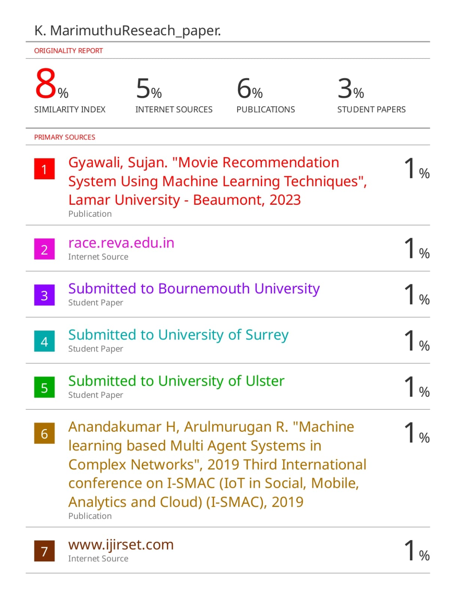
Plagiarism Report

Slide 22
References
[1] Chuang Zhao, Hongke Zhao, Ming He, Jian Zhang, & Jianping Fan (2023). Cross-domain Recommendation via User Interest Alignment.
https://www.google.co.in/url?sa=t&source=web&rct=j&opi=89978449&url=https://dl.acm.org/doi/fullHtml/10.1145/3543507.3583263&ved=2ahUKEwj8sfeF2pCJAxWfV2wGHdbDPPUQFnoECBsQAQ&usg=AOvVaw1WHZASCnY3R_iHBzM4j-QZ
[2] Sara Shafiee (2023). Unveiling the Latest Trends and Advancements in Machine Learning Algorithms for Recommender Systems: A Literature Review."
https://www.sciencedirect.com/science/article/pii/S2212827123009575/pdf?md5=3900e509175fa5d6562503cc9d895246&pid=1-s2.0-S2212827123009575-main.pdf
[3] A. Esteban, A. Zafra, & C. Romero (2023). Helping University Students Choose Elective Courses by Using a Hybrid Multi-criteria Recommendation System with Genetic Optimization. https://scholar.google.co.in/scholar?q=elective+recommendation+system+research+pa
per&hl=en&as_sdt=0&as_vis=1&oi=scholart#d=gs_qabs&t=1729009697572&u=%23p%3Di9kC7JtkA4sJ
[4] Dr. D. V. Divakara Rao, Dr. P. M. Manohar, A. Venkatesh, A. Lokesh Kumar, & Abhinav (2023).
Course Recommendation System Using Machine Learning.
https://www.google.co.in/url?sa=t&source=web&rct=j&opi=89978449&url=https://www.journaldogorangsang.in/no_1_Online_23/13_apr.pdf&ved=2ahUKEwjz88LH2ZCJAxW8SGwGHfbCvsQFnoECBUQAQ&usg=AOvVaw0wyxbMoojjbsiRgrbF7Ziq
[5] Pramila M. Chawan (2022). Recommendation System using Machine Learning
Techniques.https://www.researchgate.net/publication/363891251_Recommendation_System_using_ Machine_Learning_Techniques
[6] Suhasini Parvatikar & Deepa Parasar (2020). Recommendation System Using Machine
Learning.https://www.google.co.in/url?sa=t&source=web&rct=j&opi=89978449&url=https://www.researchgate.net/publication/353985266_Recommendation_system_using_machine_learning&ved=2ahUKEwiJlJmA25CJAxV0Q2cHHdJfF6kQFnoECBwQAQ&usg=AOvVaw1L_jAOFFKQsq9ugXIU WFyz

Slide 23
Thank You

